Slide 1
Cybersecurity Hygiene
…because you might be picking your friend’s nose.
Sam Sneed
June 2017

Slide 3
Yes, it is your problem
What you don’t know will hurt you.

Slide 4
Why people hack
Money
Organized online crime
Personal or Political Agenda
State actors
Lulz
Vandalism
Disgruntled employees
New methods to commit old crimes
Curiosity
“Hacktivists”

Slide 5
Why everyone is a juicy target
Information
Access
Personnel files
Critical business info
Financial (banking, credit, etc.)
Health (medical records, prescriptions, etc.)
Physical location or things
Intellectual property
Networks and devices
Information or more access

Slide 6
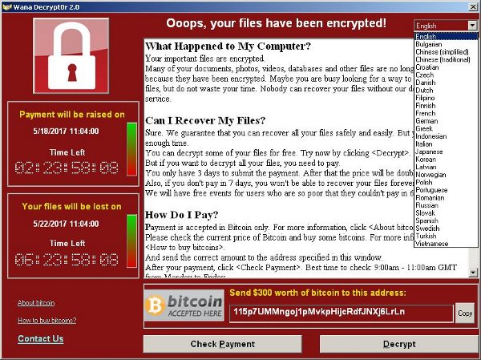
What could happen when you’re hit
Create backdoors, load additional code
Loss of control of devices
Exfiltration of info
Encryption of files
Ask for ransom
Nothing (yet)

Slide 7
Folk wisdom for the digital age
Exploits and Current Events
Practical Tips

Slide 8
Don’t take candy from strangers
If in doubt, don’t click
Attachments may contain malware
Links can take you to compromised websites
“Phishing” common method of attack
Can use spoofing, social engineering, other methods to trick users into accessing infected files or websites

Slide 9
Don’t take candy from strangers (If in doubt, don’t click)
Scan email and attachments
Check with IT to see if this can be done automatically
Use blacklists/ whitelists to control access
Call and verify with the sender

Slide 10
Don’t eat things off the ground
Think before you connect
How public is the network?
How secure is the device?
Man-in-the-middle attacks
Dyn attack, October 2016
IoT devices infected w/ malware* became botnet (baby monitors, printers, cameras)
DDoS attacks took down major online services and retailers
* The malware used, “Mirai,” is Japanese for “the future”

Slide 11
Don’t eat things off the ground (Beware of free lunch)
Avoid public networks, especially open ones
Avoid logging into sensitive services while on a public network
Consider using a VPN or mobile network
Do you really need an internet-connected teapot?

Slide 12
Don’t share cooties
Think about who and what you interact with
What is their cybersecurity hygiene like?
Where have their devices been?
Where have those thumb drives been?

Slide 13
Don’t share cooties
Consider the terms of accessing your company network
May employees connect personal devices to the work network?
Do contractors have access?
Beware of “jailbroken” devices
Consider options like mobile device management software
Scan media (e.g. thumb drives) if they are coming in from unknown sources

Slide 14
Pick up after yourself
A place for every password and every password in its place
Where do you keep your credentials?
When’s the last time you cleaned them out?
Are credentials doubled up?
How many devices across how many networks have you used your credentials on?

Slide 15
Pick up after yourself
Info and credentials should have an expiration date
Mind your passwords
Don’t double up on credential usage
How many post-its are you using?
Consider using a password manager

Slide 16
Lock your doors
Are you taking full advantage of security tools?
Weak passwords are easy to crack
Brute force
Password dictionaries
Access controls frequently have publicly-accessible control panels and/or default admin passwords

Slide 17
Lock your doors
Use lock screens on mobile devices
Mind your passwords
Length (8+)
Complexity (Upper case, lower case, number, special character)
Don’t forget about physical security
Change your factory default passwords
Consider multi-factor authentication

Slide 18
Wash your hands and take your vitamins
How often does your computer get a checkup?
Automated scans?
Software updated?
WannaCry, May 2017
Affected unpatched Microsoft operating systems
Supported OS could patch in March 2017 (Windows Vista, 7, 8.1, 10)
Unsupported OS had no patch (XP, others)

Slide 19
Wash your hands and take your vitamins
Keep your software updated
Consider SaaS models
Get regular checkups
Schedule regular scans
Don’t ignore warning signs
Error messages sometimes have important things to say

Slide 20
making it work for your organization
Training
Processes
Documentation

Slide 21
Take stock of your operations
PEOPLE
THINGS
Function (Access control? Critical asset?)
Mobile?
Owner?
PEOPLE + THINGS
Inside - workflows and data lifecycle
Outside - access and transfer
Employee lifecycle
Categories of users

Slide 22
What is your risk tolerance?
Liability for protected information
Health
Financial
Info re children
Security-related
Relationship to customers and vendors
Business continuity

Slide 23
Formalize, document, and train!
Policies and agreements
IP and employment
Data classification
Data retention (lifecycle handling)
BYOD and network access
Training and documentation
Onboarding and offboarding
Periodic training, changes in access rights

Slide 24
Find Expertise and Help
Inside your organization
Departments – IT, HR, Legal
Levels – Executive, front-line
Generations – consider reverse mentoring
Outside your organization
Technical expertise
Insurance
Incident response

Slide 25
Questions?

